Slide 1
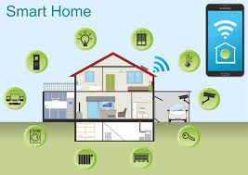
HOME AUTOMATION SYSTEM
DEPARTMENT OF ELECTRONICS AND TELECOMMUNICATION
DEBAJIT SAHA
MAINAK DEY
ANANYA GHOSH
DEBARUN KANJILAL
SOUMAJIT KARMAKAR

Slide 2
AGENDA :
INTRODUCTION
FUNCTIONAL OVERVIEW
APPLICATIONS
COMPONENTS
DATASHEET OF COMPONENTS
CIRCUIT DIAGRAM
WORKING PRINCIPLE
ADVANTAGES
LIMITATIONS
FUTURE WORKS
LESSON LEARNED
CHALLENGES
REFERENCES

Slide 3
INTRODUCTION :
Nowadays, we have remote controls for our television sets and other electronic systems, which have made our lives real easy. Have you ever wondered about home automation which would give the facility of controlling tube lights, fans and other electrical appliances at home using a remote control? Of course, Yes! But,are the available options cost-effective? If the answer is No, we have found a solution to it. We have come up with a new system called Home Automation using Wi-Fi module Node MCU ESP8266. This system is super-cost effective and can give the user the ability to control any electronic device without even spending for a remote control. This project helps the user to control all the electronic devicesusing his/her smartphone.
Time is a very valuable thing. Everybody wants to save time as much as they can. New technologies are being introduced to save our time. To save people’s time we are introducing Home Automation system using Wi-Fi module. With the help of this system we can control our home appliances from our mobile phones. You can turn on/off your home appliances within the range of Wi-Fi . It is a fully open source solution

Slide 4
Functional overview: (controlling & monitoring devices over the internet)
Automatic camera on/off by motion sensor.
Main door open/close detection by IR sensor.
Automatic AC on/off by temperature sensor.
Alarm when smoke detected by smoke sensor.
Application controlled through Mobile phone.
Notification via Email & sms.

Slide 5
APPLICATIONS :
TV
REFRIGERATOR
FANS
LIGHTS
WATER HEATER
AIR CONDITIONER
OTHER APPLIANCES

Slide 6
COMPONENTS :
Node MCU ESP8266 Wi-Fi Module
IR SENSOR
SERVO MOTOR
DC ADAPTER
RESISTORS(100 ohms)
JUMPER & CONNECTING WIRES
LEDs
VERO BOARD
7805 VOLTAGE REGULATOR
Motion sensor
Temperature sensor
SMOKE SENSOR

Slide 7
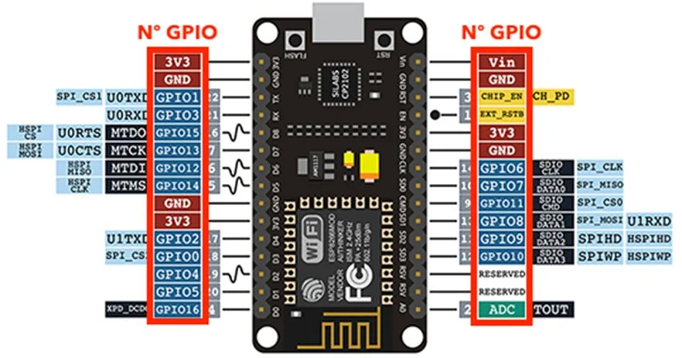
Node MCU esp8266
Node MCU is an open-source firmware and development kit that helps you to prototype or build IoT products. It includes firmware that runs on the ESP8266 Wi-Fi SoC from Espressif Systems, and hardware which is based on the ESP-12 module. ... It is based on the eLua a project and built on the Espressif Non-OS SDK for ESP8266.

Slide 8
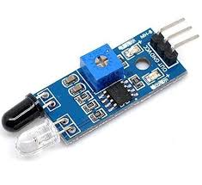
IR SENSOR
An infrared sensor is an electronic device, that emits in order to sense some aspects of the surroundings. An IR sensor can measure the heat of an object as well as detects the motion. These types of sensors measure only infrared radiation, rather than emitting it that is called a passive IR sensor.

Slide 9
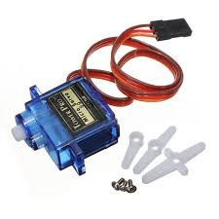
SERVO MOTOR
A servo motor is an electrical device which can push or rotate an object with great precision. If you want to rotate and object at some specific angles or distance, then you use servo motor. It is just made up of simple motor which run through servo mechanism.

Slide 10
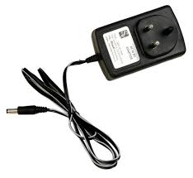
DC ADAPTER
Most DC adapters were linear power supplies, containing a transformer to convert the mains electricity voltage to a lower voltage, a rectifier to convert it to pulsating DC, and a filter to smooth the pulsating waveform to DC, with residual ripple variations small enough to leave the powered device

Slide 11
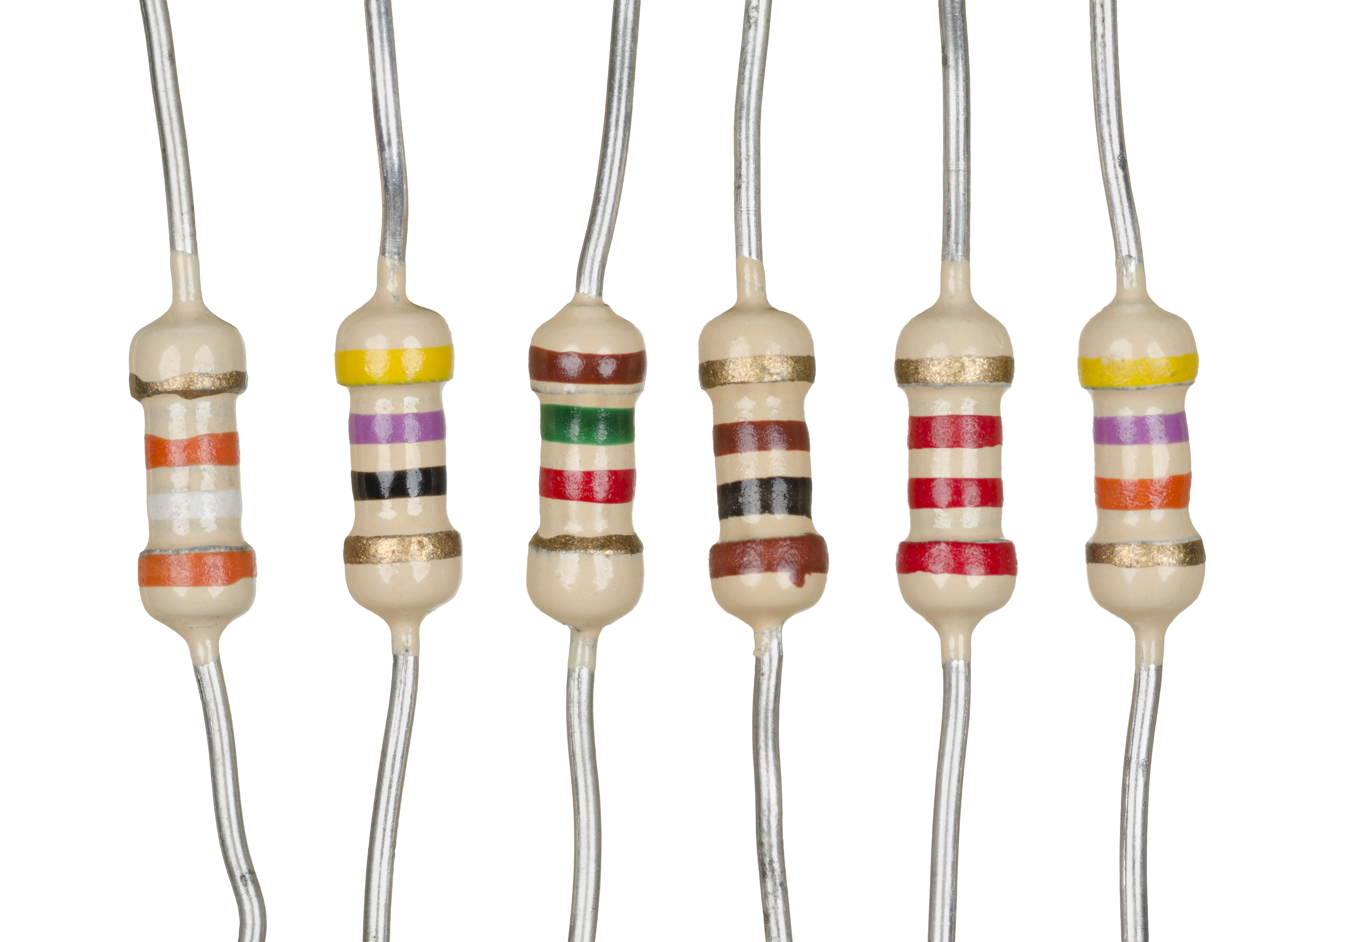
RESISTORS
A resistor is a passive two-terminal electrical component that implements electrical resistance as a circuit element. In electronic circuits, resistors are used to reduce current flow, adjust signal levels, to divide voltages, bias active elements, and terminate transmission lines, among other uses.

Slide 12
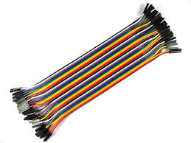
JUMPER WIRES & CONNECTING WIRES
Jumper wires are simply wires that have connector pins at each end, allowing them to be used to connect two points to each other without soldering. Jumper wires are typically used with breadboards and other prototyping tools in order to make it easy to change a circuit as needed.

Slide 13
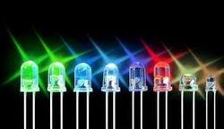
LED
A light-emitting diode (LED) is a semiconductor light source that emits light when current flows through it. Electrons in the semiconductor recombine with electron holes, releasing energy in the form of photons. ... Recent developments have produced high-output white light LEDs suitable for room and outdoor area lighting.

Slide 14
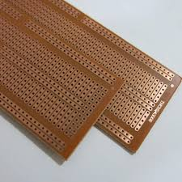
VERO BOARD
Veroboard is a brand of strip board, a pre-formed circuit board material of copper strips on an insulating bonded paper board which was originated and developed in the early 1960s by the electronics Department of (VPE). It was introduced as a general-purpose material for use in constructing electronics circuit differing from purpose-designed printed circuit board (PCBs) in that a variety of electronics circuits may be constructed using a standard wiring board.
The first single-size Veroboard product was the forerunner of the numerous types of prototype wiring board which, with worldwide use over five decades, have become known as stripboard.

Slide 15
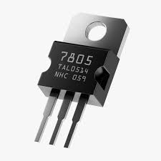
VOLTAGE REGULATER(IC 7805)
A regulated power supply is very much essential for several electronic devices due to the semiconductor material employed in them have a fixed rate of current as well as voltage. The device may get damaged if there is any deviation from the fixed rate.

Slide 16
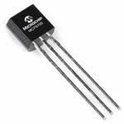
TEMPERATURE SENSOR
A temperature sensor is an electronic device that measures the temperature of its environment and converts the input data into electronic data to record, monitor, or signal temperature changes .

Slide 17
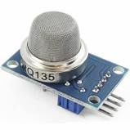
GAS SENSOR
A gas detector is a device that detects the presence of gases in an area, often as part of a safety system. This type of equipment is used to detect a gas leak or other emissions and can interface with a control system so a process can be automatically shut down. A gas detector can sound an alarm to operators in the area where the leak is occurring, giving them the opportunity to leave. This type of device is important because there are many gases that can be harmful to organic life, such as humans or animals.

Slide 18
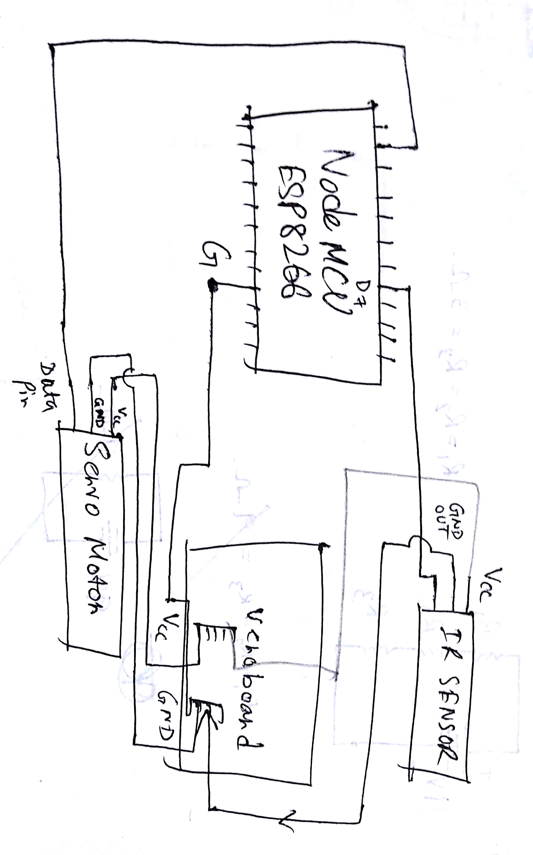
CIRCUIT DIAGRAM :

Slide 19
Advantages:
Save electricity
Control home appliances from anywhere in the home
Quick response.
You will receive a email or SMS for any activity.
Helps for safety purpose.
Monitoring 24/7.

Slide 20
DISADVANTAGES:
HIGH COST
DEPENDENCY ON INTERNET
POWER SUPPLY REQUIRED

Slide 21
FUTURE WORKS
Fingerprint security system.
RADIO FREQUENCY IDENTIFICATION (RFID) enabled Door system.
Power by solar system.
Automatic cut off between solar &main power.
Connection should be parking System.
Data Analytics-appliance useage

Slide 22
Lesson learned
Making IoT based Applications.
Connecting different sensors.
Coding-C Programming.
Problem solving.
Risk management.

Slide 23
CHALLENGES
Servo motor damaged
Damaged Wires
Burnt LED
Coding of temperature sensor

Slide 24
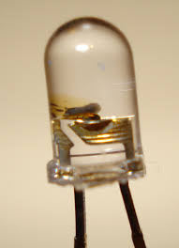
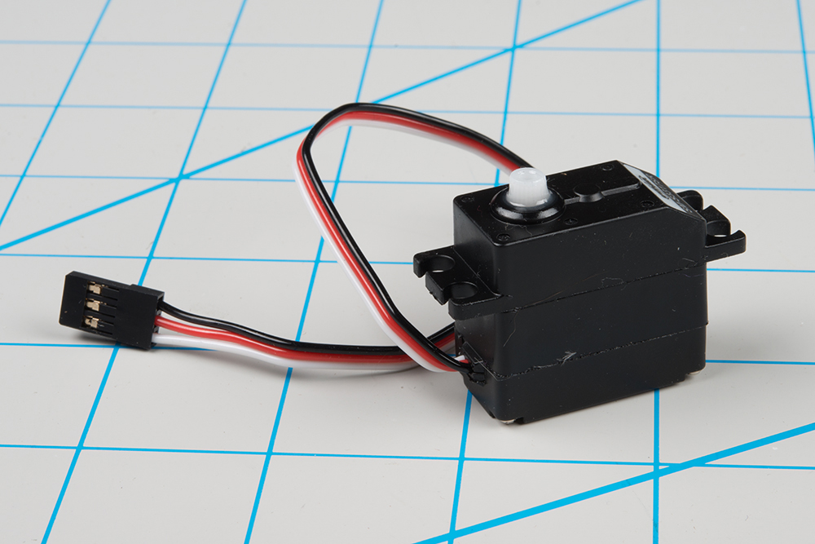
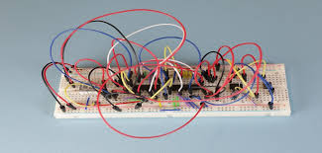
PROVED
damaged wires
burnt led light
damaged servo motor

Slide 25
REFERENCE:
Prasetio , S. R. Akbar and B. Priyambadha , "Implementation of semantic system in the smart home lights device based on agent," 2017 International Conference on Sustainable Information Engineering and Technology (SIET), Malang, 2017, pp. 93-99.
H. Durani, M. Sheth , M. Vaghasia and S. Kotech, "Smart Automated Home Application using IoT with Blynk App," 2018 Second International Conference on Inventive Communication and Computational Technologies (ICICCT), Coimbatore, 2018, pp. 393-397.
H. K. Singh, S. Verma, S. Pal and K. Pandey, "A step towards Home Automation using IOT," 2019 Twelfth International Conference on Contemporary Computing (IC3), Noida, India, 2019, pp. 1-5.
K. Sangsanit and C. Techapanupreeda , "Node MCU Choreography Automation by CoAP ," 2019 International Conference on Information Networking (ICOIN), Kuala Lumpur, Malaysia, 2019, pp. 350-353.

Slide 26
REFERENCE
M. Al-Kuwari, A. Ramadan, Y. Ismael, L. Al-Sughair, A. Gastli and M. Benammar, "Smart-home automation using IoT-based sensing and monitoring platform," 2018 IEEE 12th International Conference on Compatibility, Power Electronics and Power Engineering (CPE-POWERENG 2018), Doha, 2018, pp. 1-6.
M. Sheth and P. Rupani, "Smart Gardening Automation using IoT With BLYNK App," 2019 3rd International Conference on Trends in Electronics and Informatics (ICOEI), Tirunelveli, India, 2019, pp. 266-270.
R. K. Kodali and K. S. Mahesh, "Low cost implementation of smart home automation," 2017 International Conference on Advances in Computing, Communications and Informatics (ICACCI), Udupi, 2017, pp. 461-466.
S. Rezwan, W. Ahmed, M. A. Mahia and M. R. Islam, "IoT Based Smart Inventory Management System for Kitchen Using Weight Sensors, LDR, LED, Arduino Mega and NodeMCU (ESP8266) Wi-Fi Module with Website and App," 2018 Fourth International Conference on Advances in Computing, Communication & Automation (ICACCA), Subang Jaya, Malaysia, 2018, pp. 1-6.
S. Sarkar, S. Gayen and S. Bilgaiyan, "Android Based Home Security Sy

Slide 27

ANY QUESTIONS?

